Slide 1


Slide 2
ONLINE OFFICE HOURS
March 14, 2017

Slide 3
Overview
How College Is Different From Law School
Three Strategies For Success In Law School
What Not To Do In Law School
Why Prepare Before Law School
Live Questions
What is KTCOOLS

Slide 4
College v. Law School

Slide 5
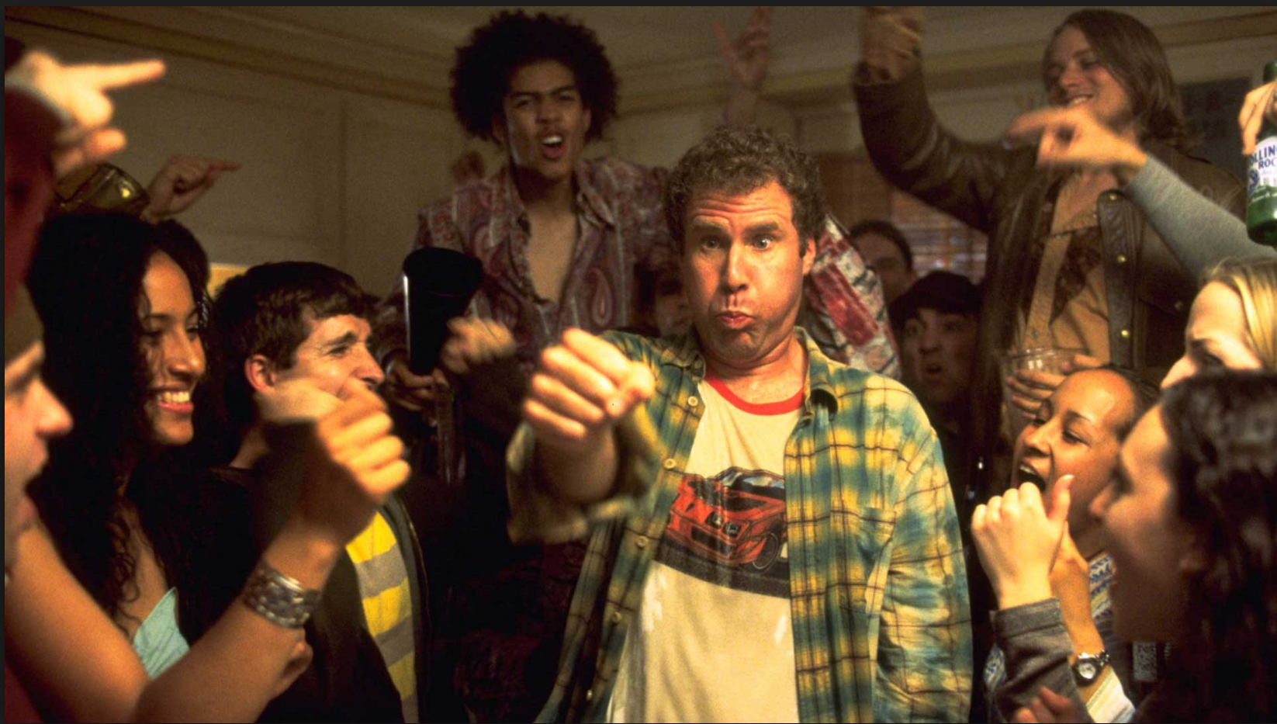
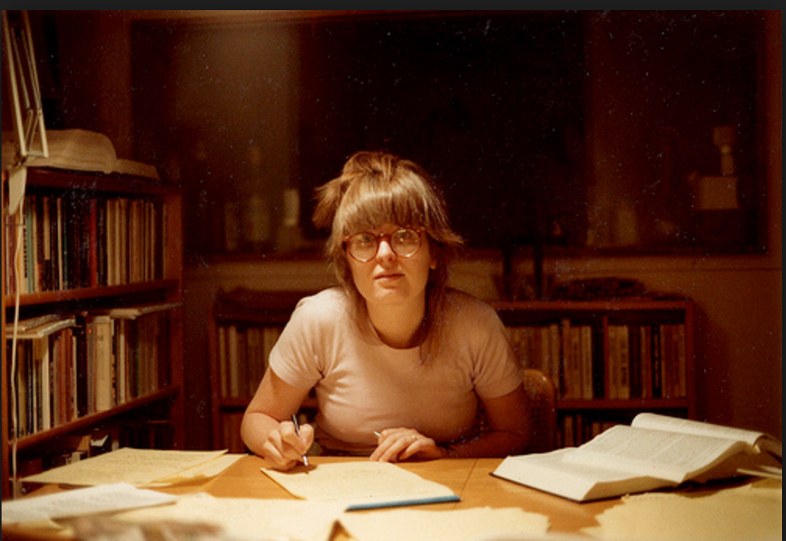
Is law school really different from college?

Slide 6

What does it take to do well in law school?
What exactly have you heard?

Slide 7
What does it take to do well in law school?
What exactly have you heard?
What are your sources for that info?

Slide 8
What does it take to do well in law school?
What exactly have you heard?
What are your sources for that info?
Is it important to do well in law school?

Slide 9

Assumptions from College
Does this sound right?

Slide 10
Assumptions from College
Does this sound right?
  Read everything

Slide 11
Assumptions from College
Does this sound right?
  Read everything
  Take notes on everything

Slide 12
Assumptions from College
Does this sound right?
  Read everything
  Take notes on everything
  Give it back to the prof

Slide 13
Assumptions from College
Does this sound right?
  Read everything
  Take notes on everything
  Give it back to the prof

Slide 14
Assumptions from College
Does this sound right?
  Read everything
  Take notes on everything
  Give it back to the prof
Q: Do you think law school is like this?

Slide 15
Law school reality
What you spend > 90% of your time doing:
  Reading badly-written cases & understanding them
    Badly written
  Listening to prof grill students on cases
    Socratic method = prof may question confused student,
    Doesn’t want to tell student answer
  Strong pressure to prepare so you don’t look stupid in class

Slide 16
Law school reality
  What you are graded on
  (& spend less than 10% time on)
    100% of grade is final exam (mostly)
    Exam does not test of reading or lecture notes.
    You solve a brand new legal problem.

Slide 17
Law school reality
    Using facts you’ve never seen, can you find,
    develop and resolve legal claims and defenses
    better than 90-95% of your class (what it takes to get the A, right)?
      Wait – this isn’t what you did in class!
  ALSO:
    You never get feedback on the exam unless you ask
    You never get professor’s feedback BEFORE the exam

Slide 18
Law school reality
School gives you no required way (like
midterms or quizzes) of knowing how you’re
doing until it’s too late
Very common reaction: “I understood the material so well, but my grade just doesn’t reflect it.”
Great students get crappy grades for the first time.

Slide 19
Summary of Differences
College
Law School
Passive learning
Knowledge
Time to recover from bad first semester
Grade Inflation
Do the work and do well
You can get help
Active Learning
Knowledge and Skills
First year makes your destiny
Hard curve
Profs hide the ball
You have to help yourself

Slide 20
Three Strategies To
Win at law school

Slide 21
STUDY options
Possibilities:
  Do exactly what profs tell you to do
  Focus on the endgame, work backwards

Slide 22
Strategy: Do what your told
Do exactly what your prof tells you
  Read cases and brief them
  In November, start outlining
  In late November take some practice exams.
  Voila!
  What’s wrong with this?

Slide 23
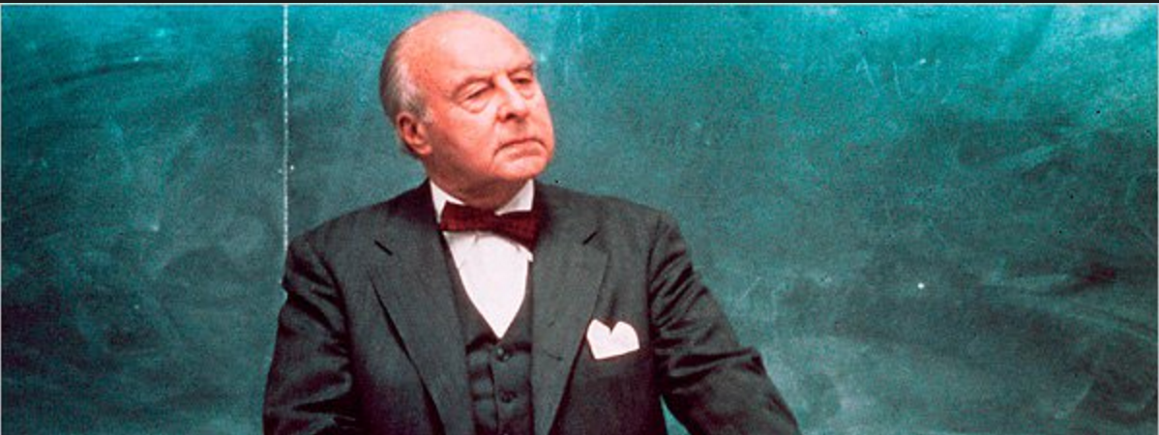
Problems with
“Do what your told”

Slide 24
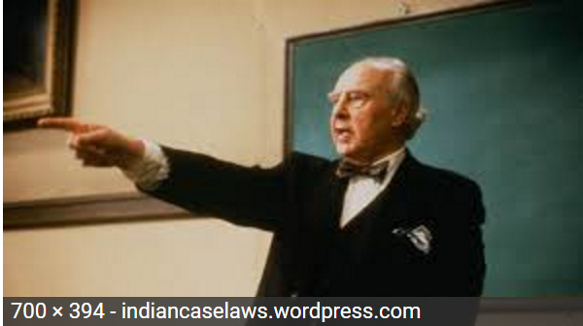
Problems with
“Do what your told”

Slide 25
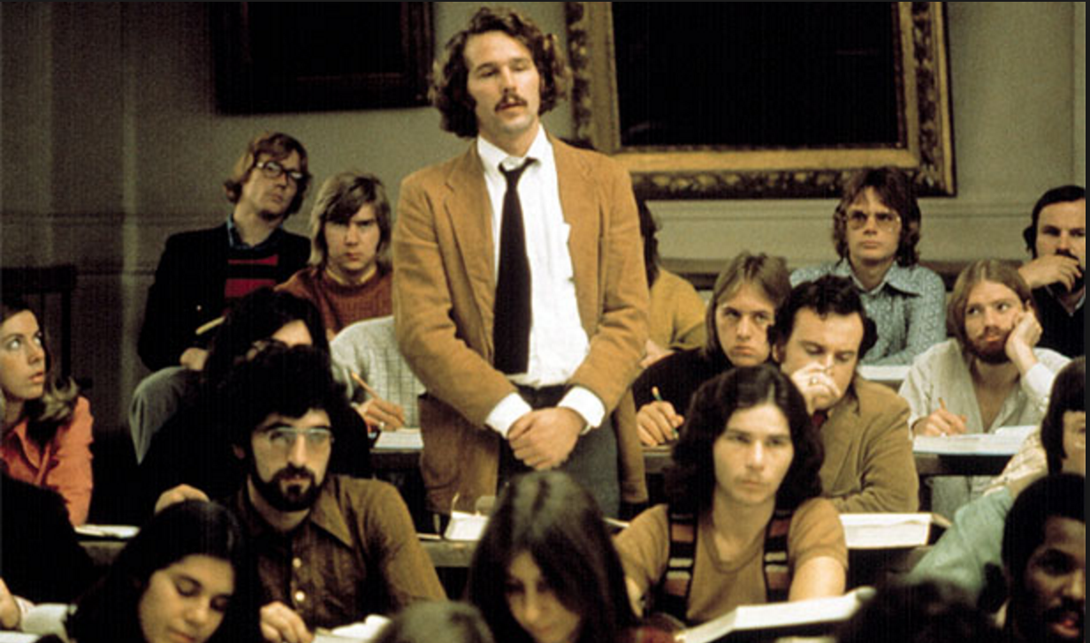
Problems with
“Do what your told”

Slide 26
Problems with
“Do what your told”

Slide 27
Problems with
“Do what your told”

Slide 28

Problems with
“Do what your told”
  Case method = time suck
    Case briefing: frog cloacas!
    Socratic method = FEAR! OBEY ME!
    Social pressure
      (fear of looking stupid in front of smart people)
    Work as stress relief (bad!)

Slide 29
Problems with
“Do what your told”
  The curve
    You are in law school with intellectual peers
    You are as smart and hard working as each other
    If you do exactly the same thing, how can you get better grades?

Slide 30
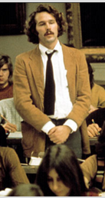
Start with the endgame and work backwards
  Chess – start with the endgame, work backwards

Slide 31
Start with the endgame and work backwards
  What is the right question here?
    What skills do I need to do well on the final exam
    Is what my prof tells me to going to help me develop those skills?

Slide 32
Start with the endgame and work backwards
Skills to do well on final exam
  Final exams = client interviews
    Here’s my story. Should I sue? Would I win?

Slide 33
Start with the endgame and work backwards
What do you need to answer these questions
  Legal knowledge
    Black letter law, not cases
  Practice answering these kinds of questions
    Analyzing issues
    Spotting issues
  Selling arguments to the judge
    Your prof is your first judge on a highly subjective exam

Slide 34
The three pillars of wisdom
Master the law
Master issue spotting
Master your professor

Slide 35
The three pillars of wisdom
Master the law,
  Elements & factors - not the cases
  Pre-study/side study – use commercial outlines
  Helps with class (and case understanding!)
  Heart surgery v. map of circulatory system

Slide 36
The three pillars of wisdom
Master issue spotting
  IRAC: Learn mechanics of issue analysis & spotting
  Practice: Take A Practice Exam A Day (TAPEAD)
  Get feedback
    Use your TAs to look at practice exams
    Trade exams with peers
    Get KTCOOLS

Slide 37
The three pillars of wisdom
Master your professor
  Study what they ‘do’; don’t do what they ‘say’
  Ignore study advice – “Rainbow Vomit”
  Focus on language, preferences (“Leningrad drunk”), hypos

Slide 38
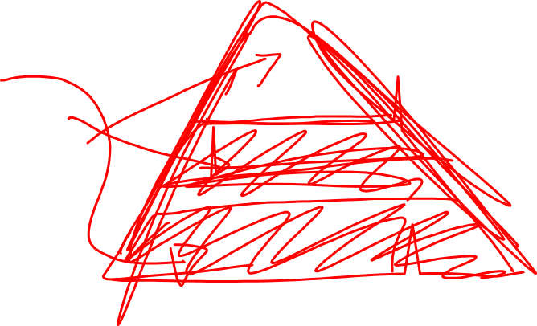
The three pillars of wisdom
An illustration:
  Master the law
  Master issue spotting
  Master your professor

Slide 39
What not to do

Slide 40
The three pillars of wisdom
Given the three pillars of wisdom . . .
  Master the law
  Master issue spotting
  Master your professor
. . . as a general rule, do nothing that doesn’t directly help you with one of these buckets.

Slide 41
The three pillars of wisdom
Specifically:
  Don’t brief cases
  Don’t re-read cases
  Don’t read long treatises
  Avoid extracurriculars

Slide 42
The three pillars of wisdom
Specifically (continued):
  Avoid long unfocused study group sessions
  Don’t over-outline

Slide 43
The three pillars of wisdom
Specifically (continued):
  Avoid long unfocused study group sessions
  Don’t obsess about outlines

Slide 44
The early bird gets the worm

Slide 45
Why prepare before law school?

Slide 46
WhY Prepare
Before Law School

Slide 47
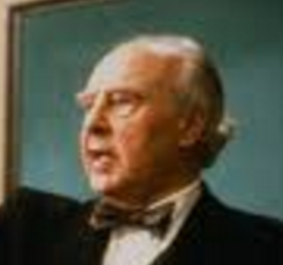
Conventional wisdom
“Preparing ahead doesn’t help you”
  You’ll see this on Reddit, Top Law Schools, etc. etc.
  Law school administrators will say this
  Law students will say this.

Slide 48

Real life Experience
“Preparing ahead totally helps you!”
  Ask him →
  My best students started at least in early summer
    Straight-A students (that really doesn’t happen; even I wasn’t)
    T14 (Harvard, NYU, Berkeley, Texas, Northwestern, etc.)
  Regrets: many with mediocre grades wish they had started sooner

Slide 49
Live Questions

Slide 50
Live Questions

Slide 51
KTCOOLS (PRIME)

Slide 52
KTCOOLS PRIME
What is missing from law school and other products:

Slide 53
KTCOOLS PRIME
What is missing from law school and other products:
  Good, battle-tested advice on general law school study skills

Slide 54
KTCOOLS PRIME
What is missing from law school and other products:
  Good, battle-tested advice on general law school study skills
  Detailed explanation of issue spotting and analysis

Slide 55
KTCOOLS PRIME
What is missing from law school and other products:
  Good, battle-tested advice on general law school study skills
  Detailed explanation of issue spotting and analysis
  A system to practice lessons and hypos

Slide 56
KTCOOLS PRIME
What is missing from law school and other products:
  Good, battle-tested advice on general law school study skills
  Detailed explanation of issue spotting and analysis
  A system to practice lessons and hypos
    In particular, students complain they don’t feel like they can take exams or hypos without knowing the law in advance.

Slide 57
KTCOOLS PRIME
What is missing from law school and other products:
  Good, battle-tested advice on general law school study skills
  Detailed explanation of issue spotting and analysis
  A system to practice lessons and hypos
    In particular, students complain they don’t feel like they can take exams or hypos without knowing the law in advance.
    Which means waiting until they finish their outlines

Slide 58
KTCOOLS PRIME
What is missing from law school and other products:
  Good, battle-tested advice on general law school study skills
  Detailed explanation of issue spotting and analysis
  A system to practice lessons and hypos
    In particular, students complain they don’t feel like they can take exams or hypos without knowing the law in advance.
    Which means waiting until they finish their outlines
    Which means they in the same boat as everyone else

Slide 59
KTCOOLS PRIME
What is missing from law school and other products:
  Good, battle-tested advice on general law school study skills
  Detailed explanation of issue spotting and analysis
  A system to practice lessons and hypos
    In particular, students complain they don’t feel like they can take exams or hypos without knowing the law in advance.
    Which means waiting until they finish their outlines
    Which means they in the same boat as everyone else

Slide 60
KTCOOLS PRIME
Kick The Crap Out Of Law School (KTCOOLS) has it all:

Slide 61
KTCOOLS PRIME
Kick The Crap Out Of Law School (KTCOOLS) has it all:
  KTCOOLS offer text/ videos on my key study skills

Slide 62
KTCOOLS PRIME
Kick The Crap Out Of Law School (KTCOOLS) has it all:
  KTCOOLS offer text/ videos on my key study skills
    Tricks no one else teaches

Slide 63
KTCOOLS PRIME
Kick The Crap Out Of Law School (KTCOOLS) has it all:
  KTCOOLS offer text/ videos on my key study skills
    Tricks no one else teaches
  KTCOOLS offers deep advice on issue spotting & analysis

Slide 64
KTCOOLS PRIME
Kick The Crap Out Of Law School (KTCOOLS) has it all:
  KTCOOLS offer text/ videos on my key study skills
    Tricks no one else teaches
  KTCOOLS offers deep advice on issue spotting & analysis
    No one breaks down this set of skills more

Slide 65
KTCOOLS PRIME
Kick The Crap Out Of Law School (KTCOOLS) has it all:
  KTCOOLS offer text/ videos on my key study skills
    Tricks no one else teaches
  KTCOOLS offers deep advice on issue spotting & analysis
    No one breaks down this set of skills more
    It’s more than just IRAC
    Subject-specific advice

Slide 66
KTCOOLS PRIME
Kick The Crap Out Of Law School (KTCOOLS) has it all:
  KTCOOLS offer text/ videos on my key study skills
    Tricks no one else teaches
  KTCOOLS offers deep advice on issue spotting & analysis
    No one breaks down this set of skills more
    It’s more than just IRAC

Slide 67
KTCOOLS PRIME
Kick The Crap Out Of Law School (KTCOOLS) has it all:
  KTCOOLS offer text/ videos on my key study skills
    Tricks no one else teaches
  KTCOOLS offers deep advice on issue spotting & analysis
    No one breaks down this set of skills more
    It’s more than just IRAC
    Subject-specific advice

Slide 68
KTCOOLS PRIME
Kick The Crap Out Of Law School (KTCOOLS) has it all:
  KTCOOLS offers bite-sized hypos and ramps up the difficulty
  KTCOOLS hypos give you the law to apply so you can practice issue spotting without having mastered all of the law

Slide 69
KTCOOLS PRIME
Kick The Crap Out Of Law School (KTCOOLS) has it all:

Slide 70
KTCOOLS PRIME
Kick The Crap Out Of Law School (KTCOOLS) has it all:
  KTCOOLS offers bite-sized hypos and ramps up the difficulty

Slide 71
KTCOOLS PRIME
Kick The Crap Out Of Law School (KTCOOLS) has it all:
  KTCOOLS offers bite-sized hypos and ramps up the difficulty
  KTCOOLS hypos give you the law to apply so you can practice issue spotting without having mastered all of the law
    This means you can build your issue spotting muscle faster than everyone else

Slide 72
KTCOOLS PRIME
Kick The Crap Out Of Law School (KTCOOLS) has it all:
  KTCOOLS offers bite-sized hypos and ramps up the difficulty
  KTCOOLS hypos give you the law to apply so you can practice issue spotting without having mastered all of the law
    This means you can build your issue spotting muscle faster than everyone else
    Which means you get better at issue spotting faster

Slide 73
KTCOOLS PRIME
Kick The Crap Out Of Law School (KTCOOLS) has it all:
  KTCOOLS offers bite-sized hypos and ramps up the difficulty
  KTCOOLS hypos give you the law to apply so you can practice issue spotting without having mastered all of the law
    This means you can build your issue spotting muscle faster than everyone else
    Which means you get better at issue spotting faster
    Which means you get better grades

Slide 74
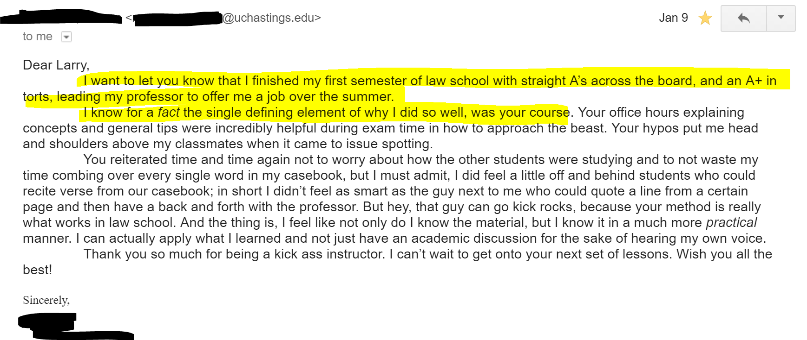
KTCOOLS PRIME
RECENT STUDENT SUCcESS

Slide 75
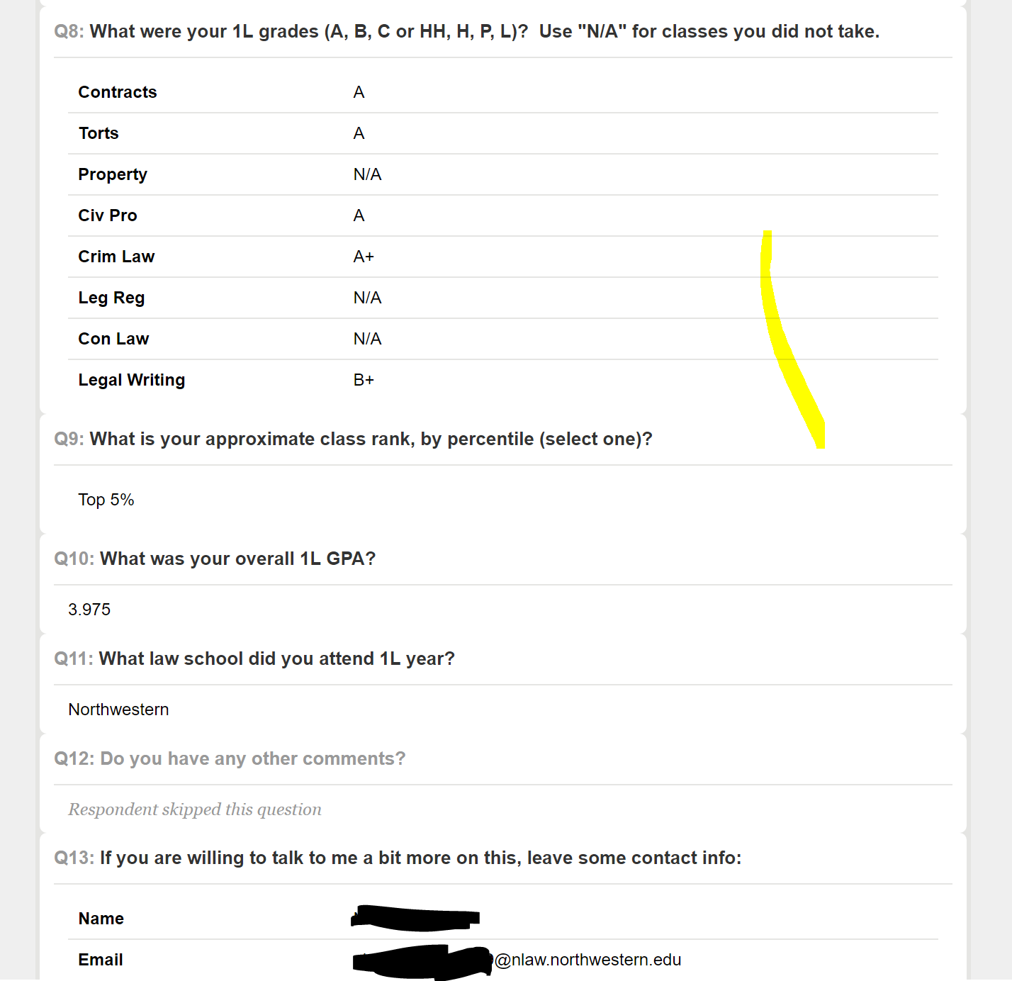
KTCOOLS PRIME
RECENT STUDENT SUCcESS

Slide 76
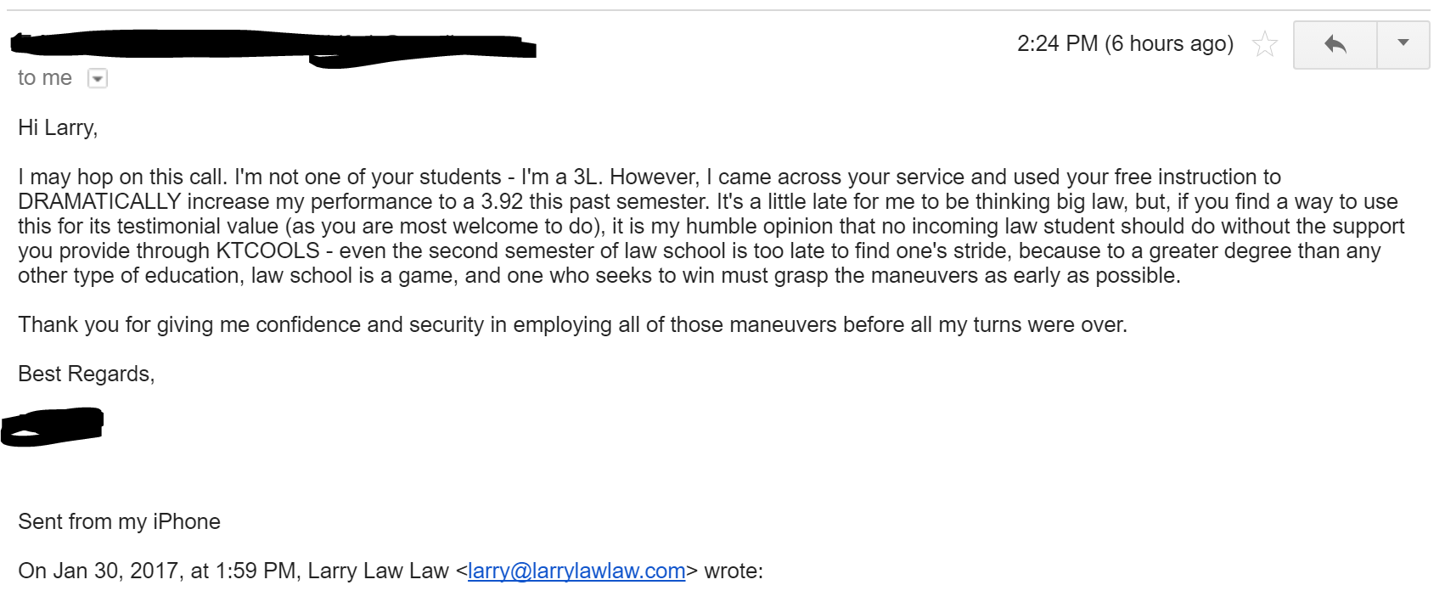
KTCOOLS PRIME
RECENT STUDENT SUCcESS

Slide 77
KTCOOLS PRIME
RECENT STUDENT SUCcESS

Slide 78
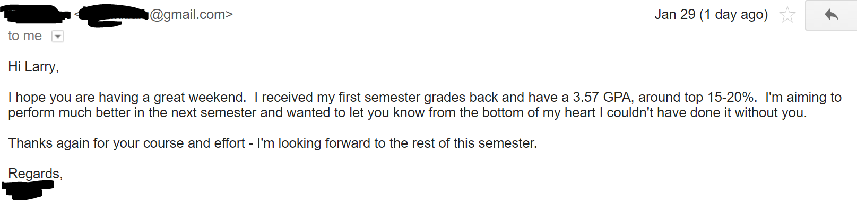
KTCOOLS PRIME
RECENT STUDENT SUCcESS

Slide 79
KTCOOLS PRIME
RECENT STUDENT SUCcESS

Slide 80
KTCOOLS PRIME
RECENT STUDENT SUCcESS

Slide 81
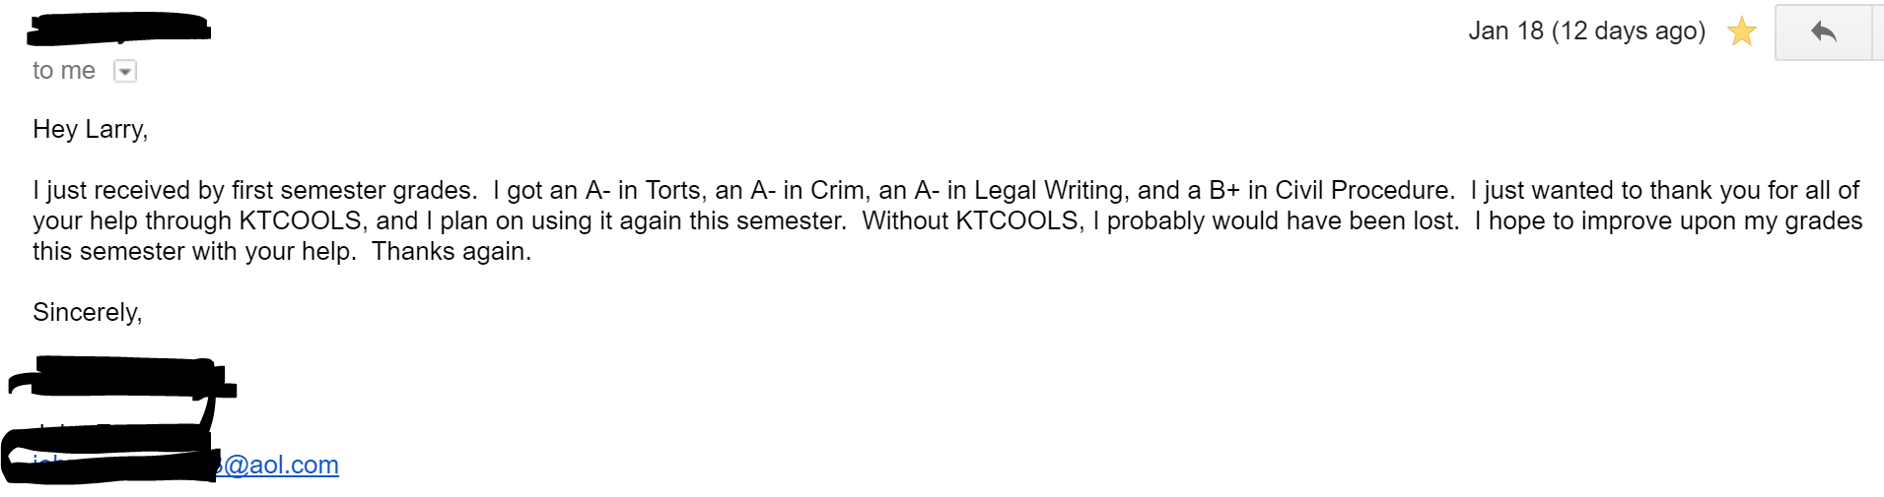
KTCOOLS PRIME
RECENT STUDENT SUCcESS

Slide 82
KTCOOLS PRIME
How do I get it?
  http://larrylawlaw.com/ktcools-sales-1/

Slide 83
Questions?

